Slide 1
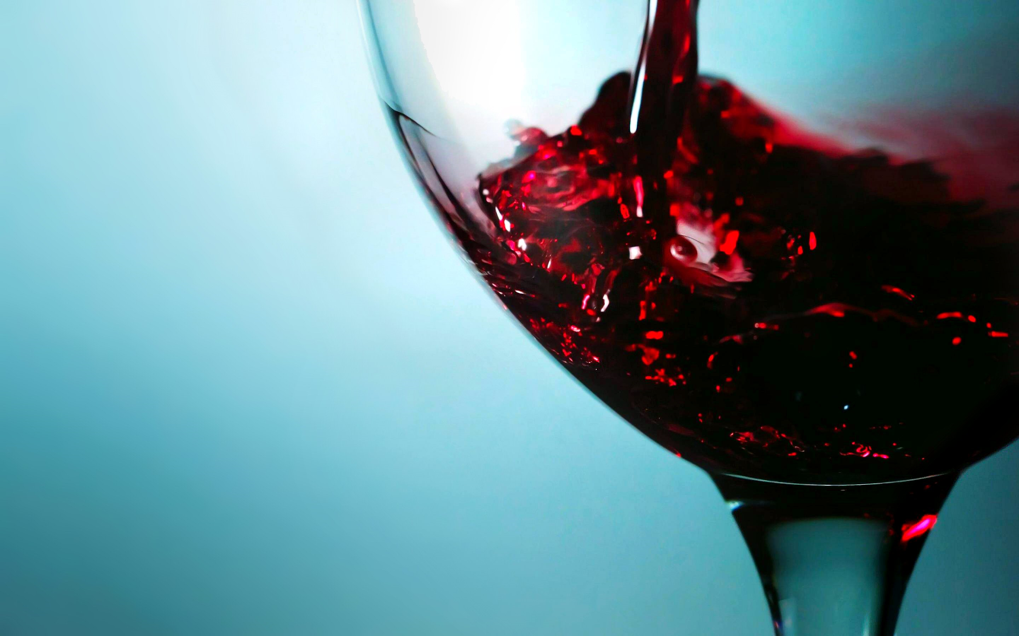

Wine Type & Quality Classification
Bala Monish Dhanuskodi
Kowshik Paramesh Venkatesh

Slide 2
Outline
Prediction objective
Data Source
Exploratory Data Analysis
Data Preprocessing
Model building
Results

Slide 3

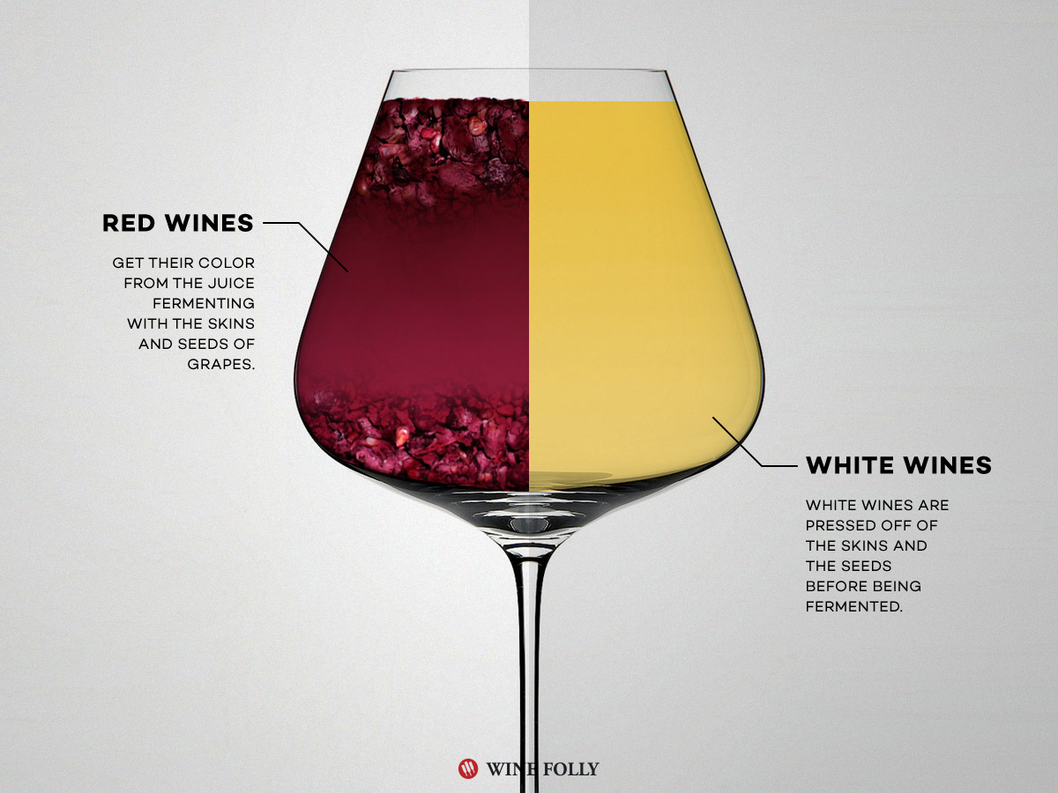
Prediction Objective
Classification
Red/White Wine
Wine Quality

Slide 4
Data Source
Dataset – downloaded from UCI Machine Learning Repository
Variants of Portuguese “Vinho Verde” wine.
13 X 6496
ATTRIBUTES
Type
Free sulfur dioxide
Total sulfur dioxide
Density
PH
Sulphates
Alcohol
Quality
Fixed Acidity
Volatile acidity
Citric acid
Residual sugar
Chlorides

Slide 5
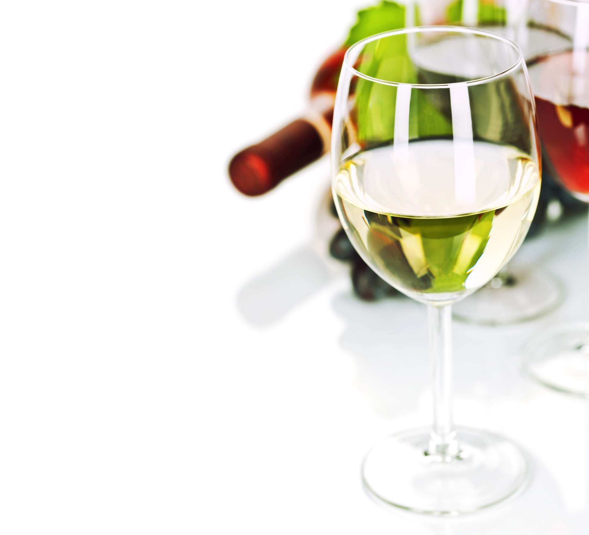
Exploratory Data Analysis

Slide 6
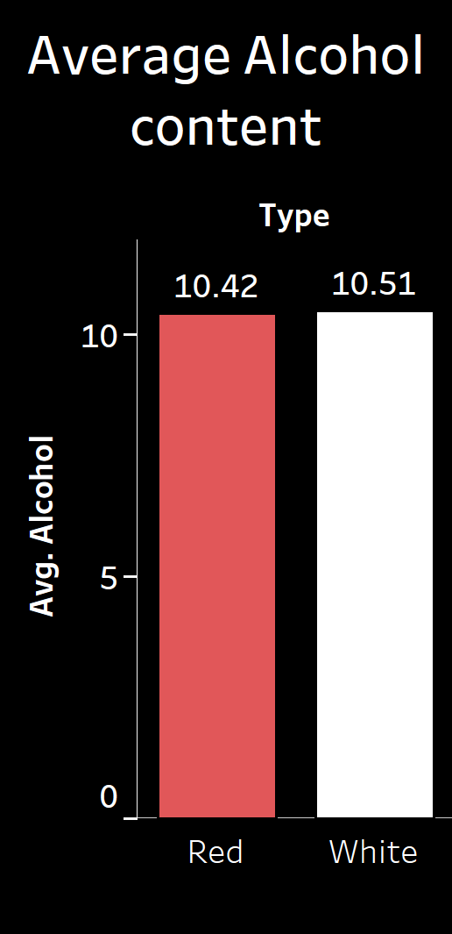
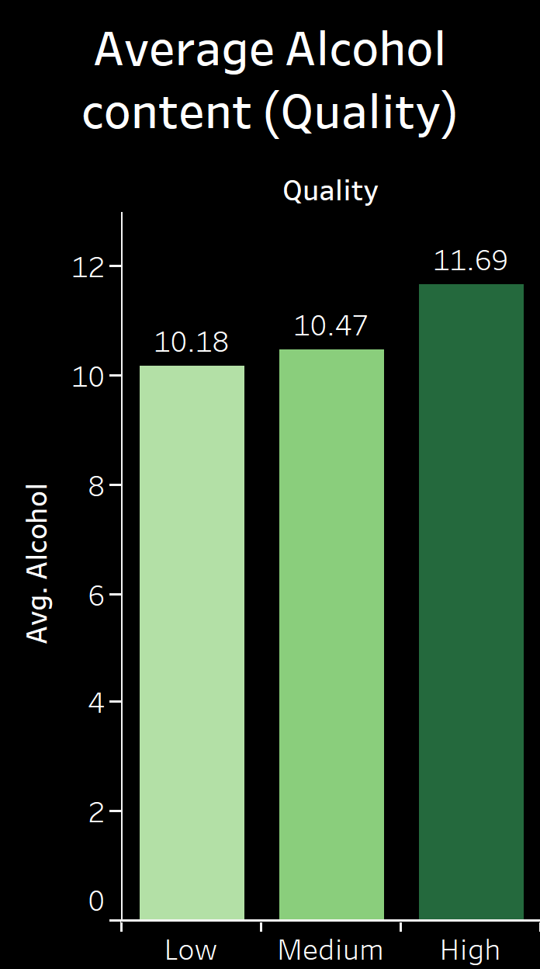
Alcohol Content Analysis
Though generally Red wine has higher Alcohol content than White, our dataset doesn’t show much difference.
But, higher the Wine quality, more the Alcohol content.

Slide 7
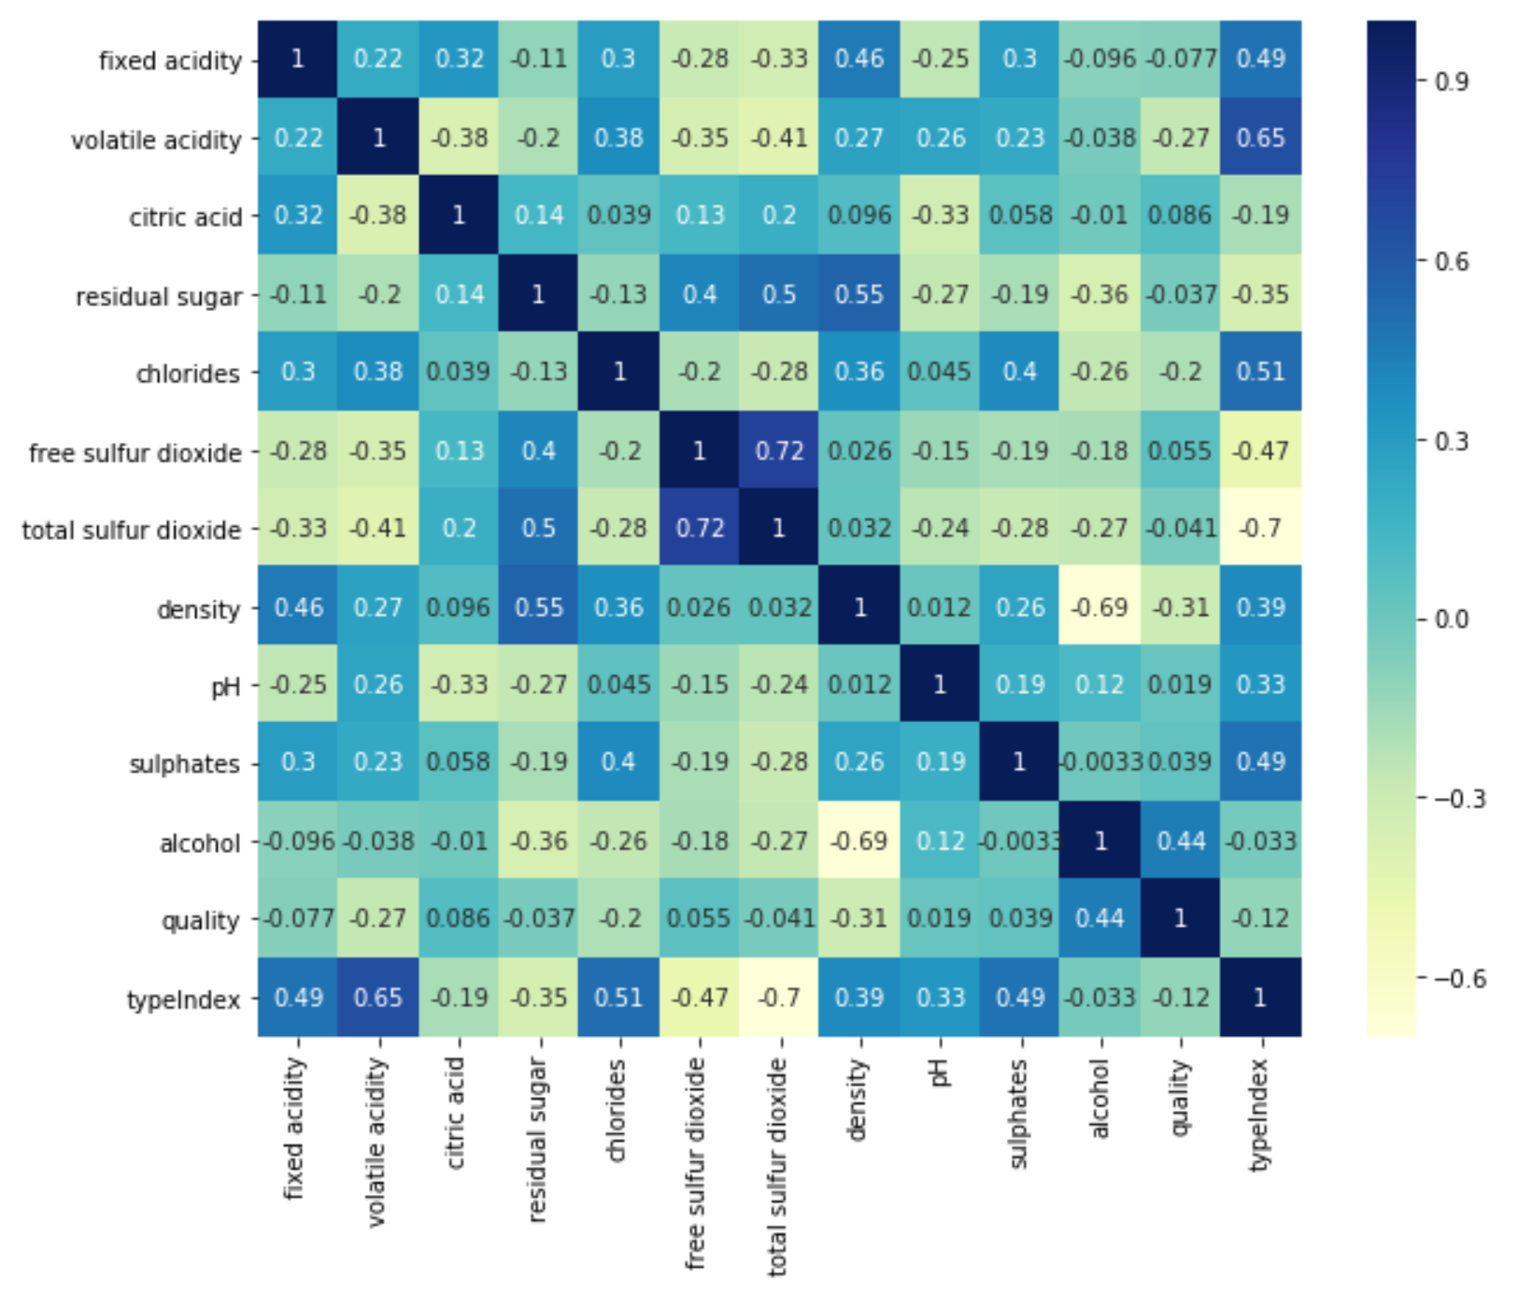
Correlation Matrix Heatmap

Slide 8
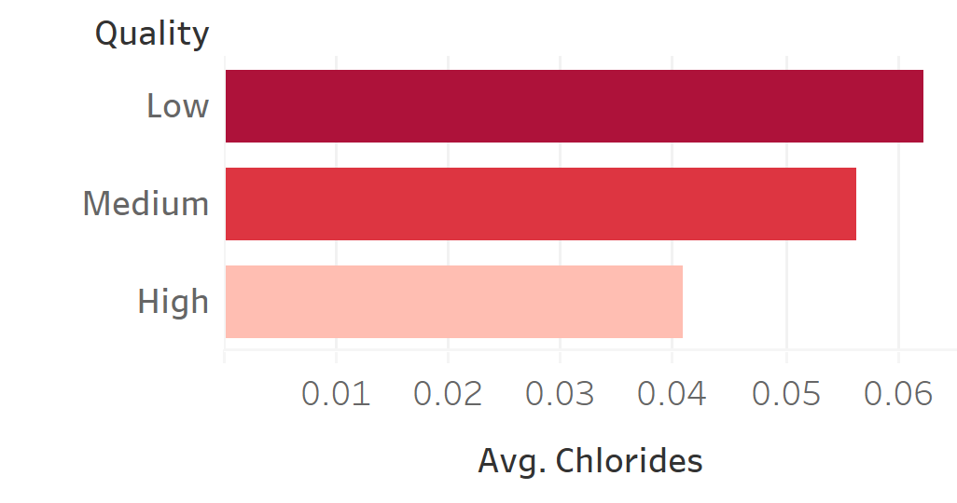
Chlorides content Vs Wine Quality
Market Research says Chlorides add Salty flavor to the Wine
Turn away customers.
Evidently seen that High quality wine has low chloride content.

Slide 9
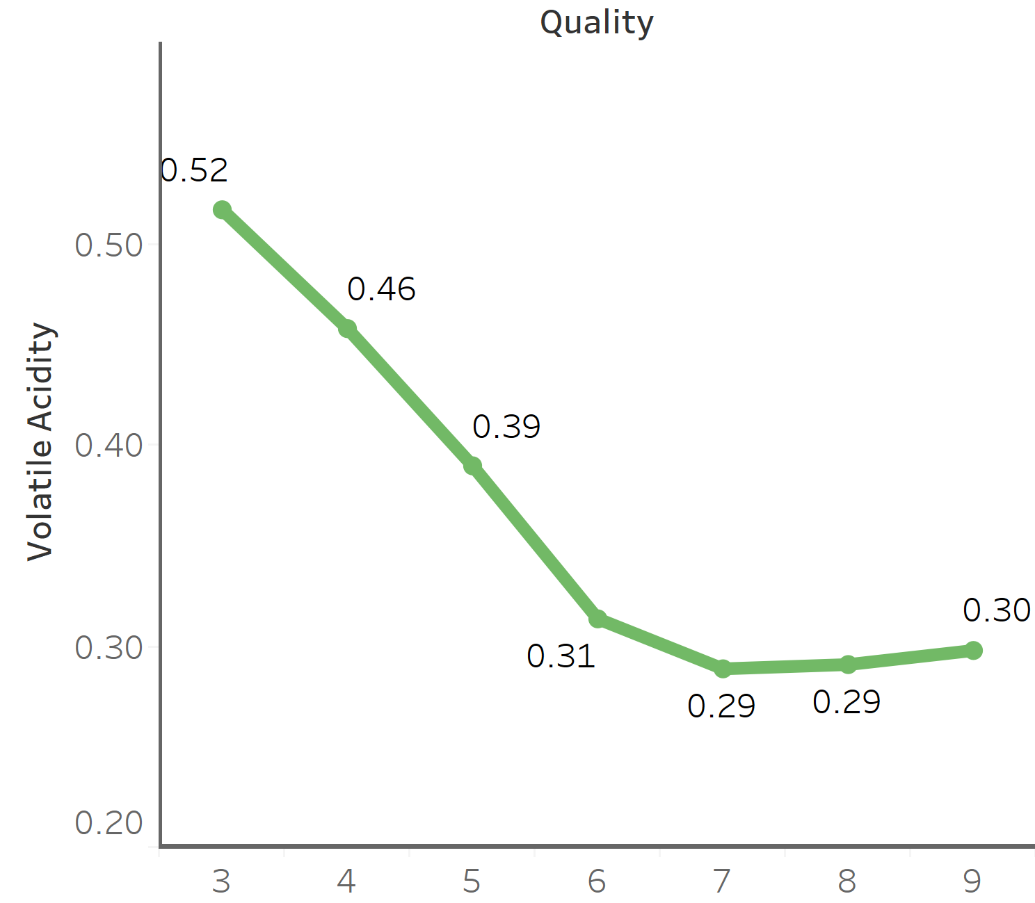
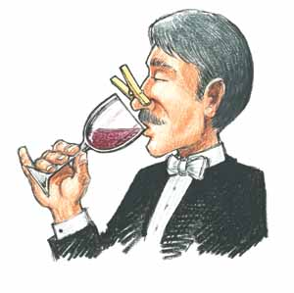
Volatile Acidity Vs Wine Quality
Volatile Acidity gives the Pungent smell to Wine
Low quality Wines have higher content of Acetic Acid.
If exceeded, the Wine will turn to Vinegar.

Slide 10
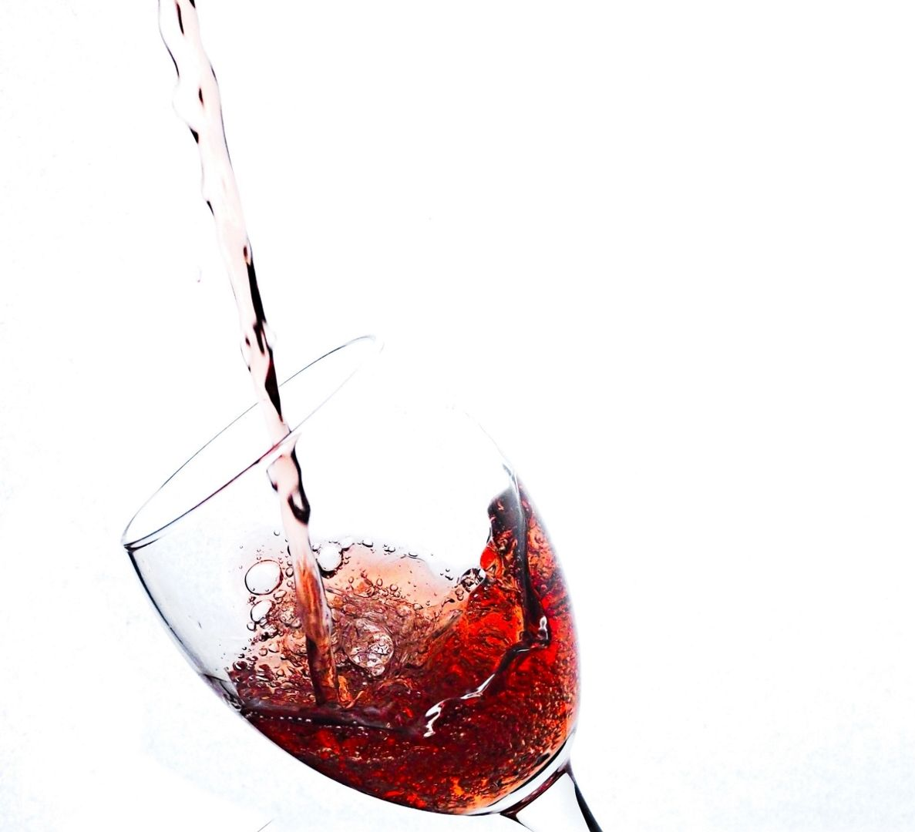
DATA PREPROCESSING

Slide 11
Feature Engineering
ML Feature – Imputer
Used Imputer function in Spark to fill the few missing values with it’s MEAN value.
Vector Assembler
Standard Scaler
To combine all the Features to a single vector column.
Normalizing each feature to have unit S.D and 0 Mean.
Binned Wine Quality
3-4 – Low (0)
5,6,7 – Medium (1)
8,9 – High(2)
String Indexing
White Wine – 0.0
Red Wine – 1.0

Slide 12
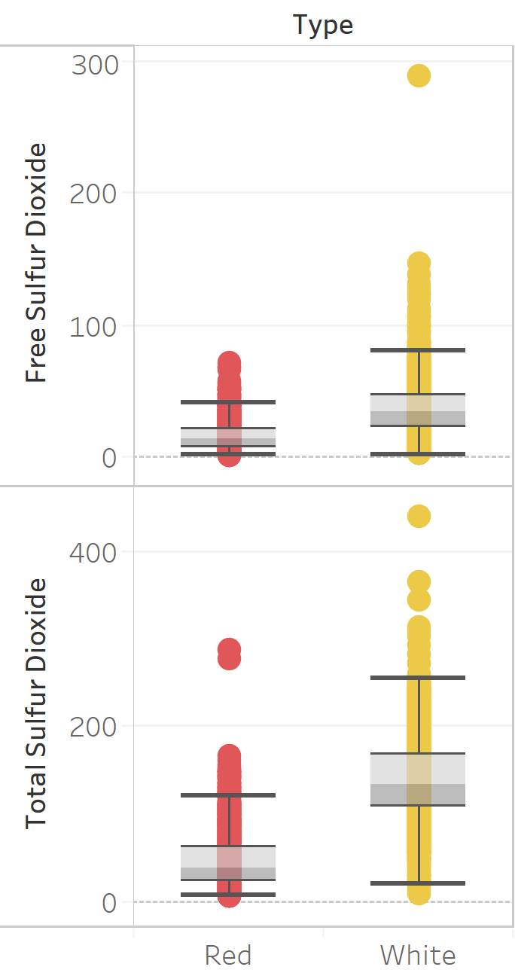
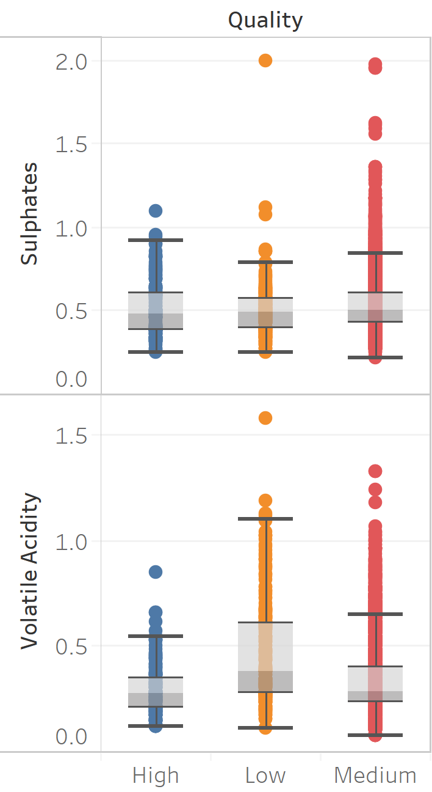
Removing Outliers
Removed the Outliers from the continuous variables which can be inferred from these Box Plots.

Slide 13
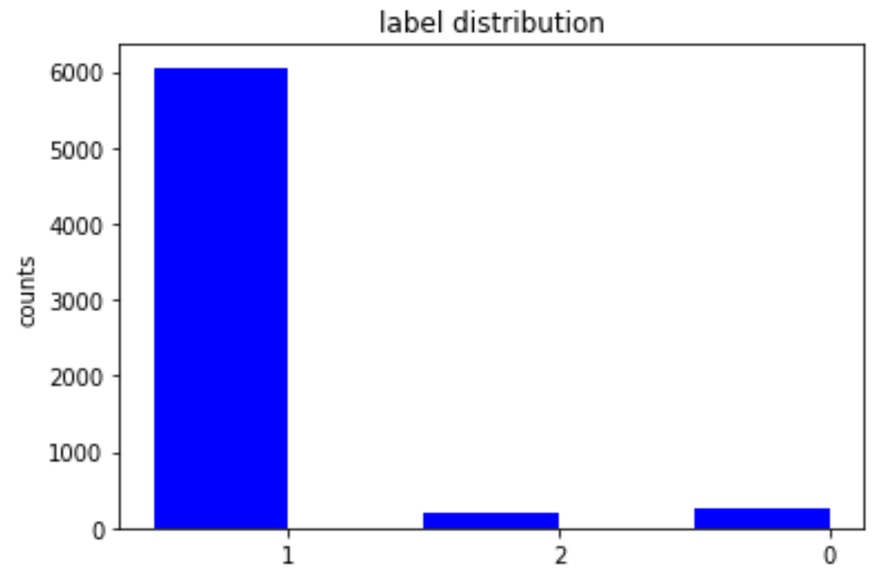
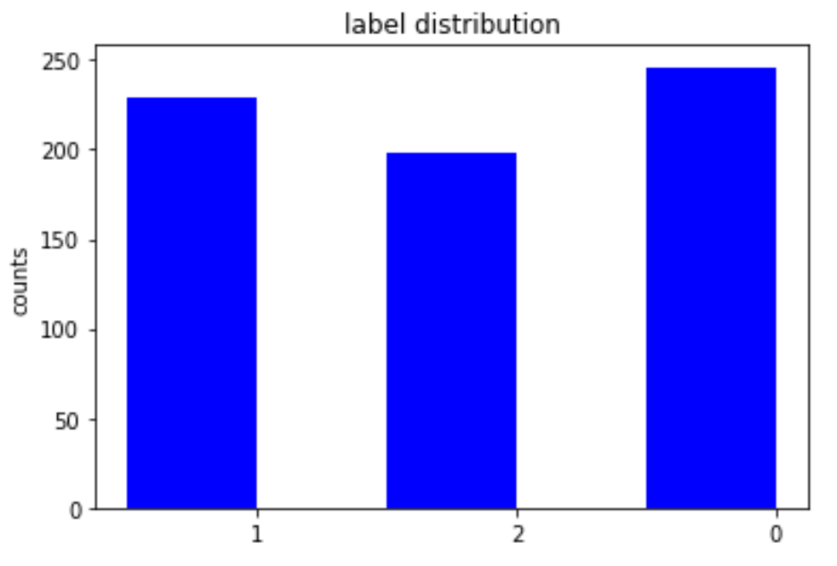
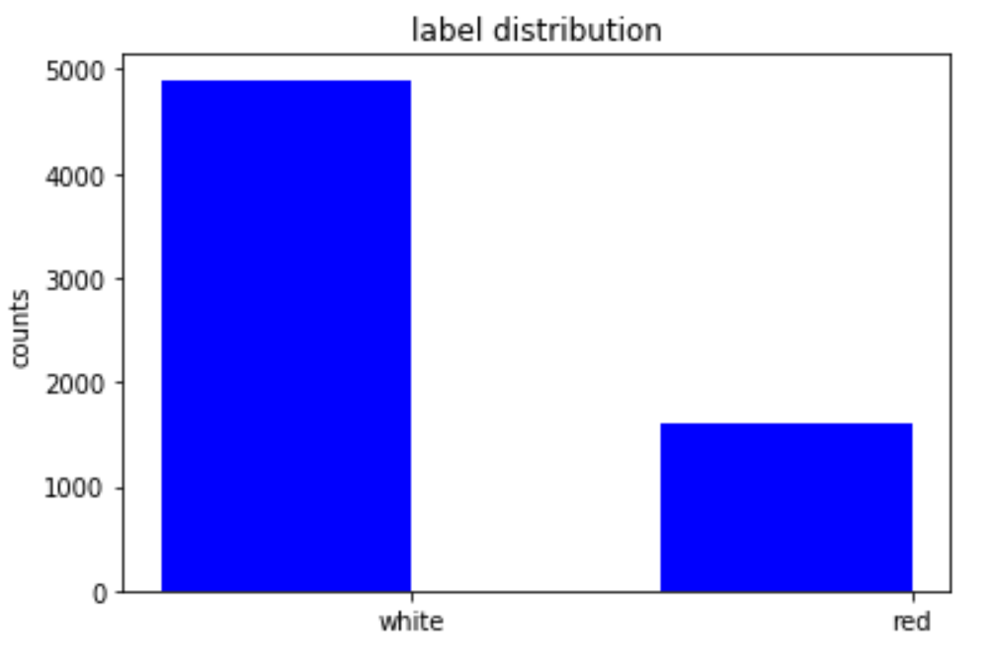
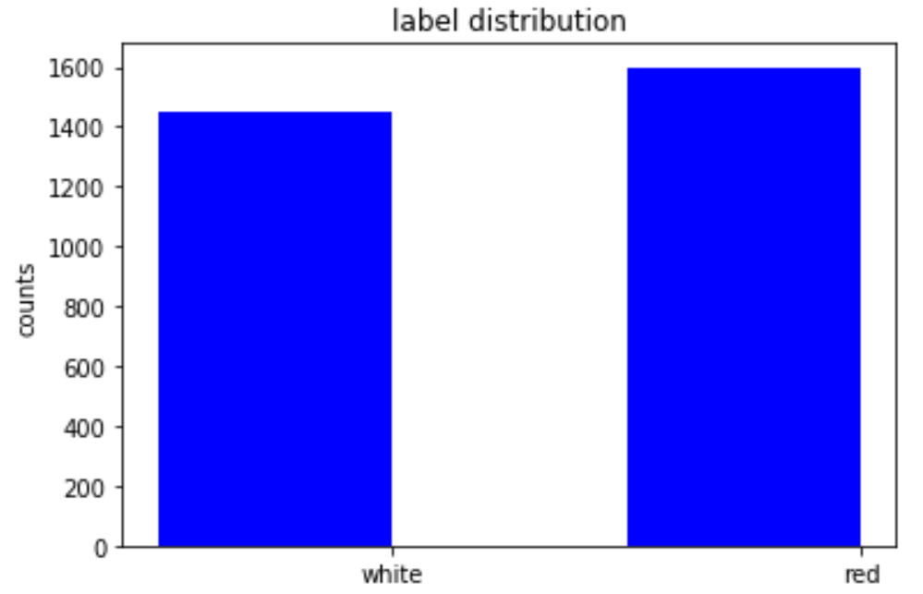
Handling Class Imbalance
Wine Quality
Under Sampling of the Majority class
Wine Type

Slide 14
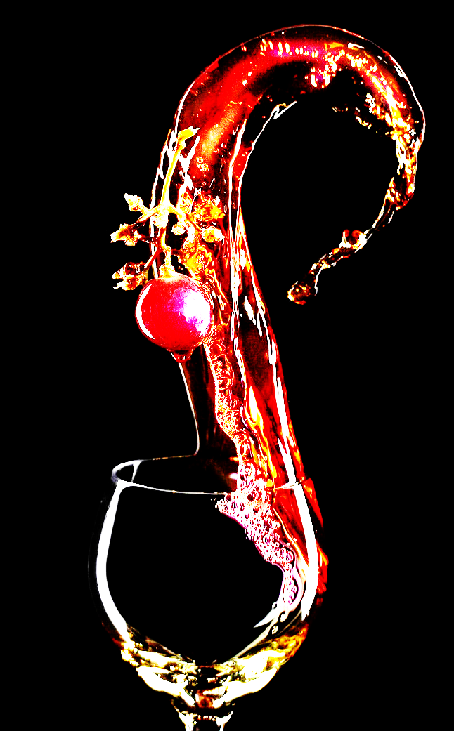
Machine Learning Models

Slide 15

Model Comparison
Wine Type Classification
Algorithms Metrics | Decision Tree | Random Forest | Logistic Regression | Gradient Boosting
Accuracy | 0.941 | 0.982 | 0.994 | 0.975
Error | 0.059 | 0.017 | 0.006 | 0.025
Precision | 0.957 | 0.982 | 0.576 | 0.975
Recall | 0.957 | 0.982 | 0.576 | 0.975
F1- Measure | 0.957 | 0.982 | 0.576 | 0.975
Area under ROC | 0.971 | 0.984 | 0.500 | 0.976

Slide 16
Model Comparison
Wine Quality Classification
Algorithms Metrics | Decision Tree | Random Forest | Logistic Regression | Naïve Bayes
Accuracy | 0.535 | 0.646 | 0.542 | 0.505
Error | 0.565 | 0.354 | 0.458 | 0.495
Precision | 0.620 | 0.646 | 0.385 | 0.505
Recall | 0.620 | 0.646 | 0.385 | 0.505
F1- Measure | 0.620 | 0.646 | 0.385 | 0.505
Area under ROC | 0.783 | 0.837 | 0.598 | 0.691

Slide 17
Hyperparameter Tuning - Cross Validation
Wine Type Classification
Max_Depth: [2, 4, 6]
Max_Bins: [20, 60]
Num_Trees: [5, 20]
Wine Quality Classification
Max_Depth: [5, 8, 10]
Max_Bins: [30, 80]
Num_Trees: [50, 200]
Accuracy: 0.997
Accuracy: 0.721
Used 5-Fold Cross Validation to improve our Prediction for Random Forest.

Slide 18
Conclusion
Best Model
Wine Type Classification – Random Forest
Wine Quality Classification – Random Forest
Future Recommendations
Didn’t see the full potential of Spark due to less sample size (6500 rows).
Including more attributes: Wine Age, Grape Type, Wine Brand, Selling Price etc.

Slide 19


